Slide 1
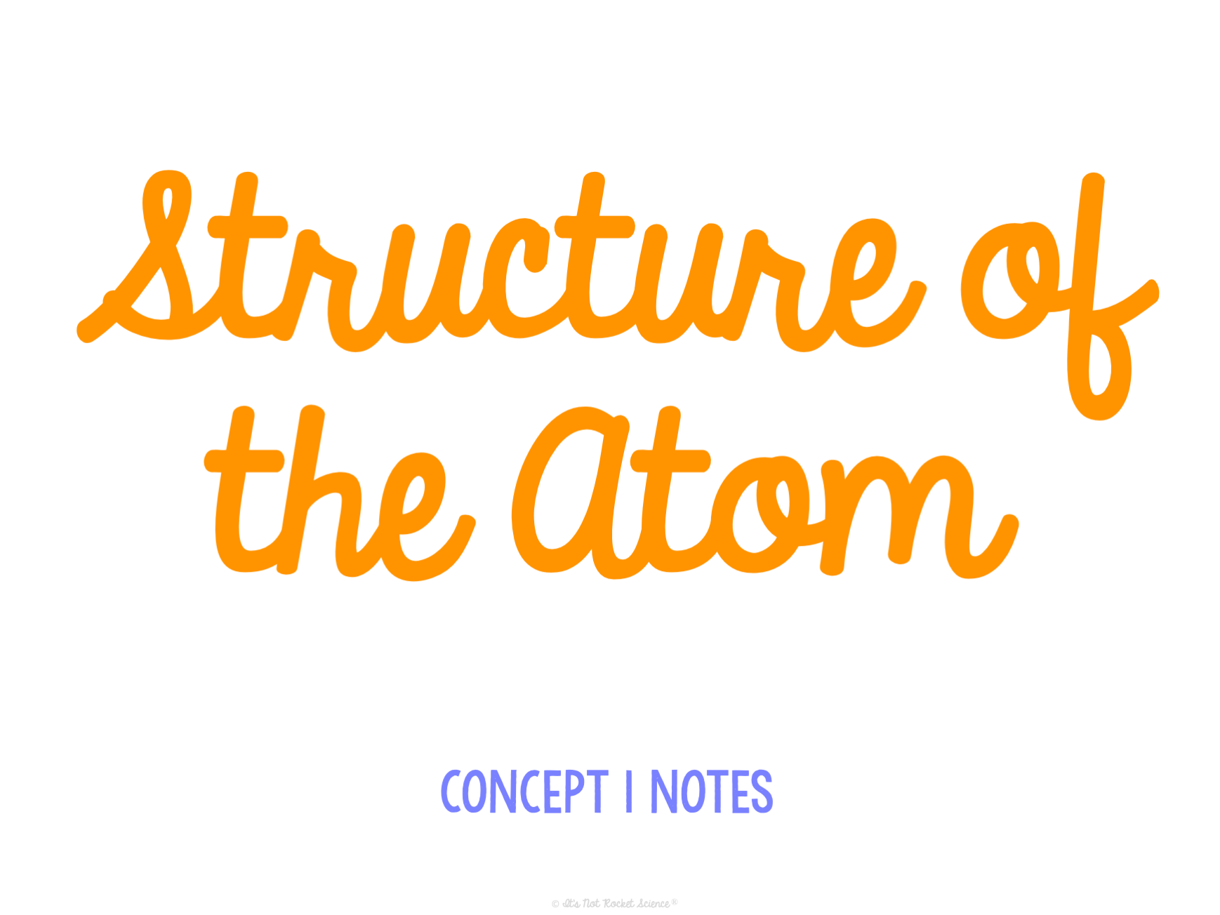

Slide 2
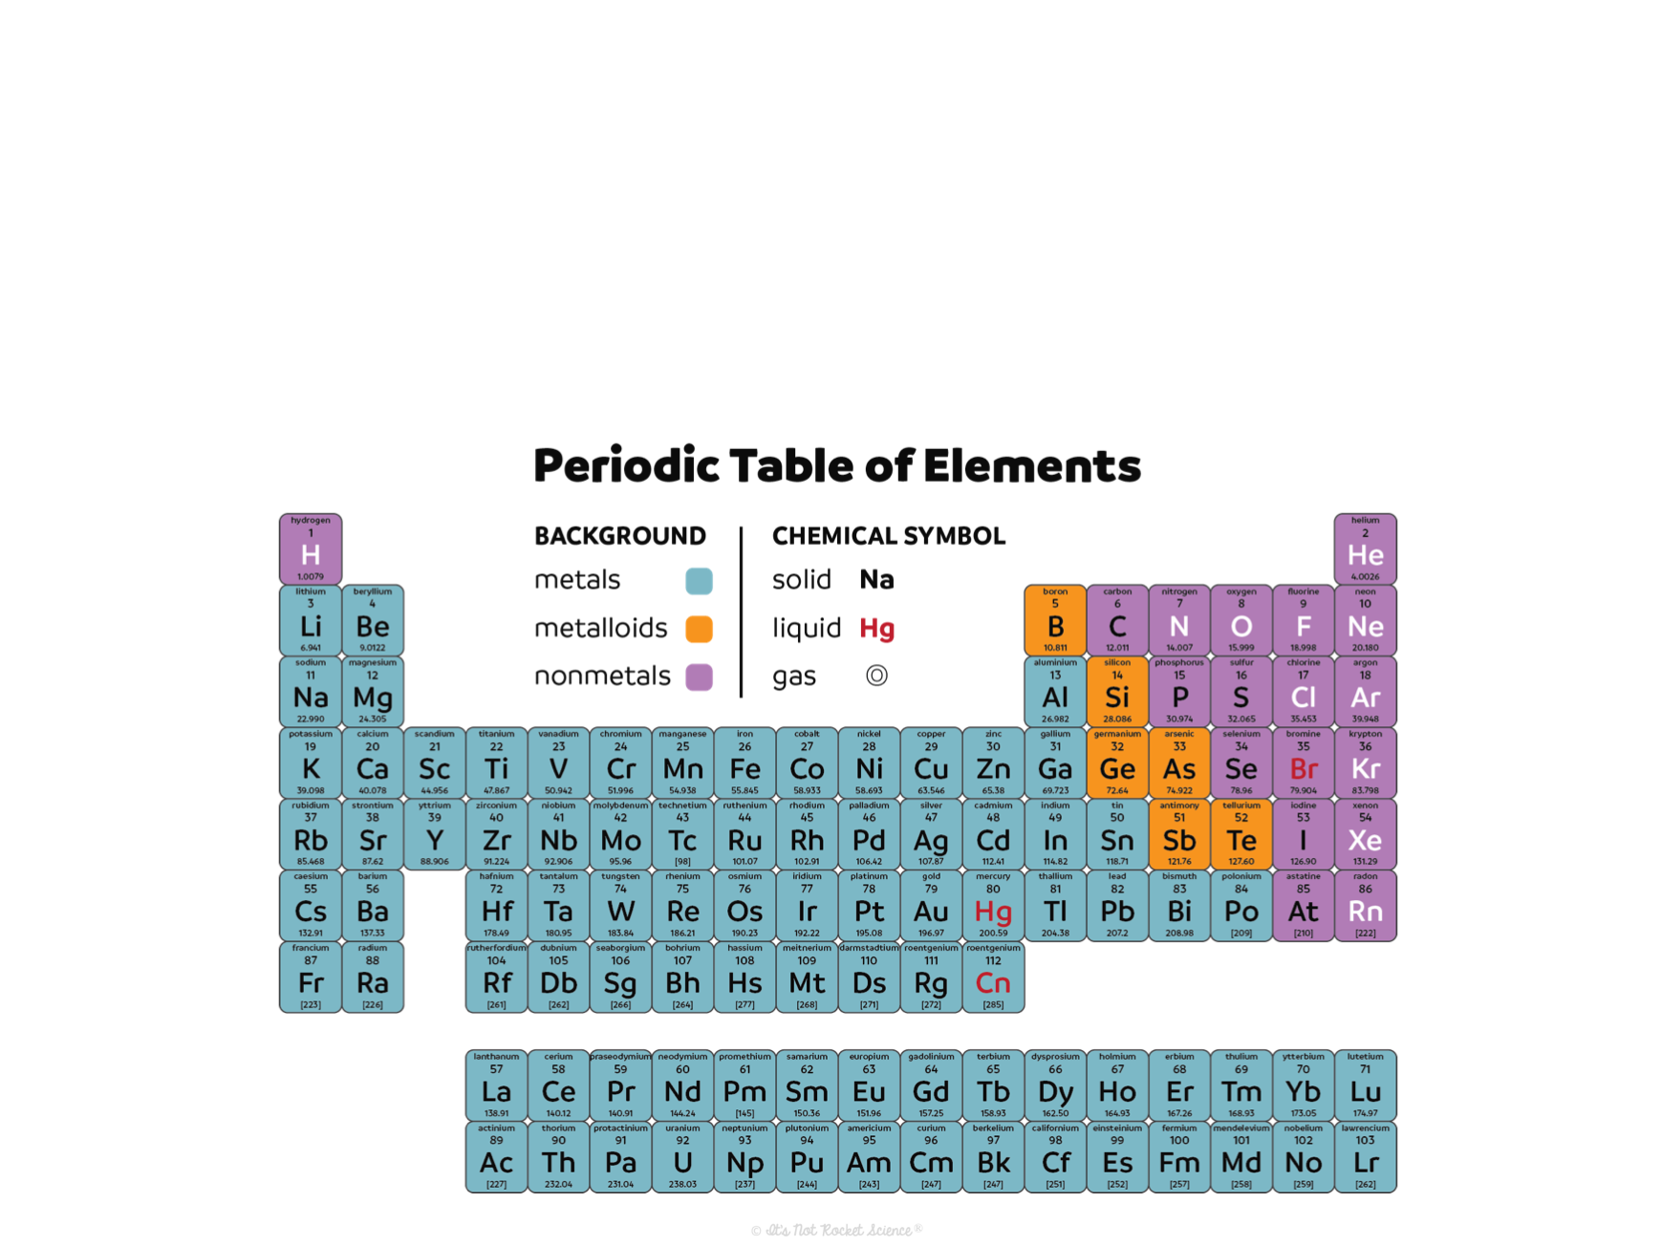
The Periodic Table
In this unit we will be learning about the elements on the periodic table. In order to do this, it is essential we understand atomic structure first.

Slide 3
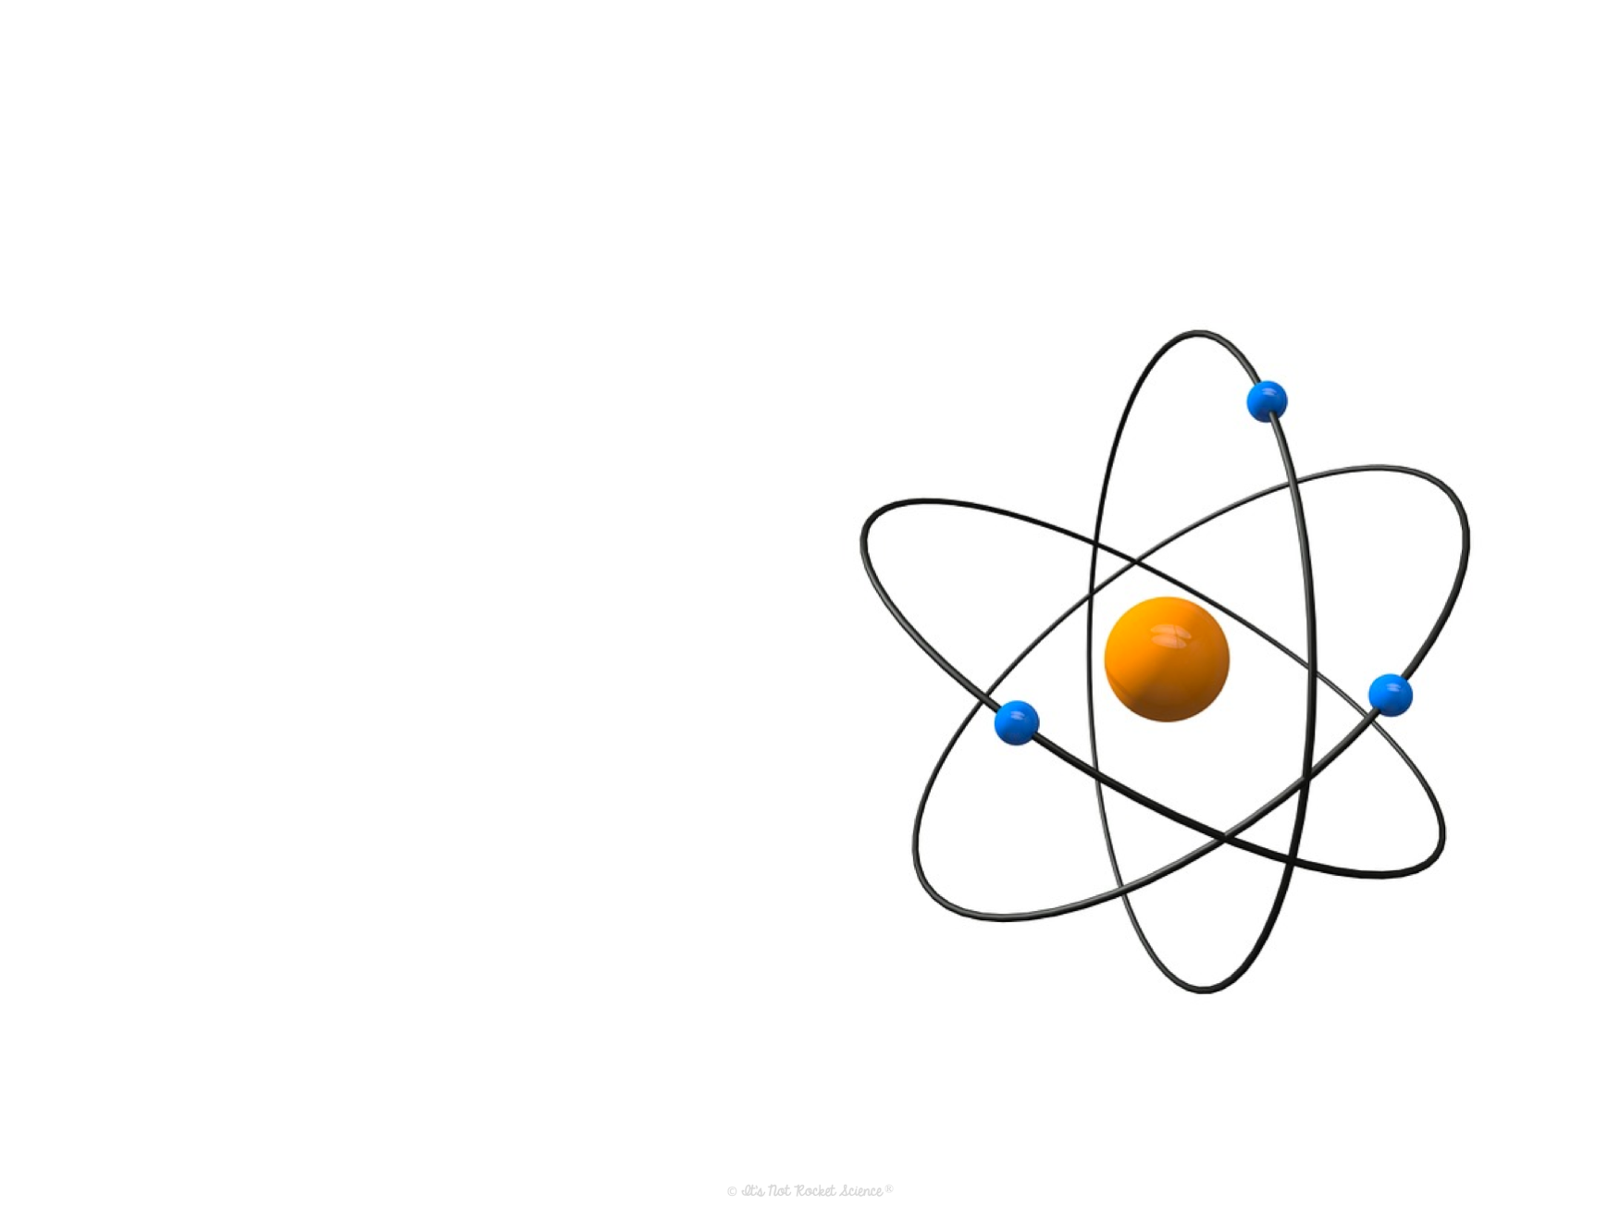
The Atom
Atom: the smallest particle of an element that still has the properties of that element.
  Remember: An element is the simplest form of matter
  Ex. Water (H₂O) is made of 2 atoms of the element hydrogen (H) and 1 atom of the element oxygen (O)

Slide 4
The Discovery of Atomic Structure
400 BC – Democritus
  First to name the atom
    Atomus means indivisible in Greek and he thought there was nothing smaller than an atom.
1803 – John Dalton’s Solid Sphere model
  Atom is a solid sphere that can’t get any smaller
  Elements are made of atoms that all have the same mass and compounds are atoms of different elements combined.
1869 – Dmitri Mendeleev
  Developed the first periodic table of elements, organized by atomic mass

Slide 5
The Discovery of Atomic Structure
1904 – JJ Thomson Plum Pudding Model
  The atom is divisible
  It is a positively charged sphere with negative particles embedded throughout
1911 – Ernest Rutherford Nuclear Model
  Gold foil experiment
  The mass of the atom and its positively charged particles were in the nucleus, with low mass negatively charged particles surrounding it.

Slide 6
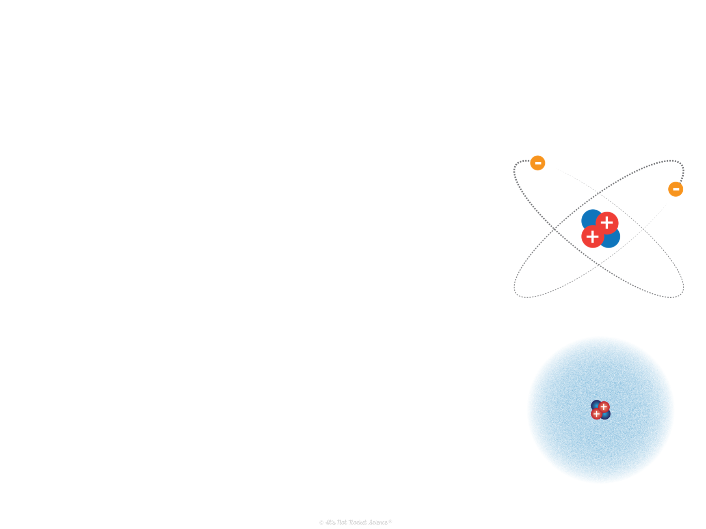
The Discovery of Atomic Structure
1913 – Henry Moseley
  Discovered the number of protons is unique to each element (atomic number) and arranged the Periodic Table this way
1913 – Niels Bohr Bohr Model
  Electrons are negative particles that travel in fixed orbits around the positively charged nucleus that is made of positive protons and neutral neutrons
1926 – Schrodinger and Heisenberg Electron Cloud model
  The nucleus is surrounded by an electron cloud that is divided into shells, but electrons do not travel in fixed orbits
Notes:
Good animation of the Electron Cloud model and how it differs from the Bohr Model: https://www.youtube.com/watch?v=FMlZq9NG_lo
(he talks really slowly though so I would leave on mute and narrate myself)

Slide 7
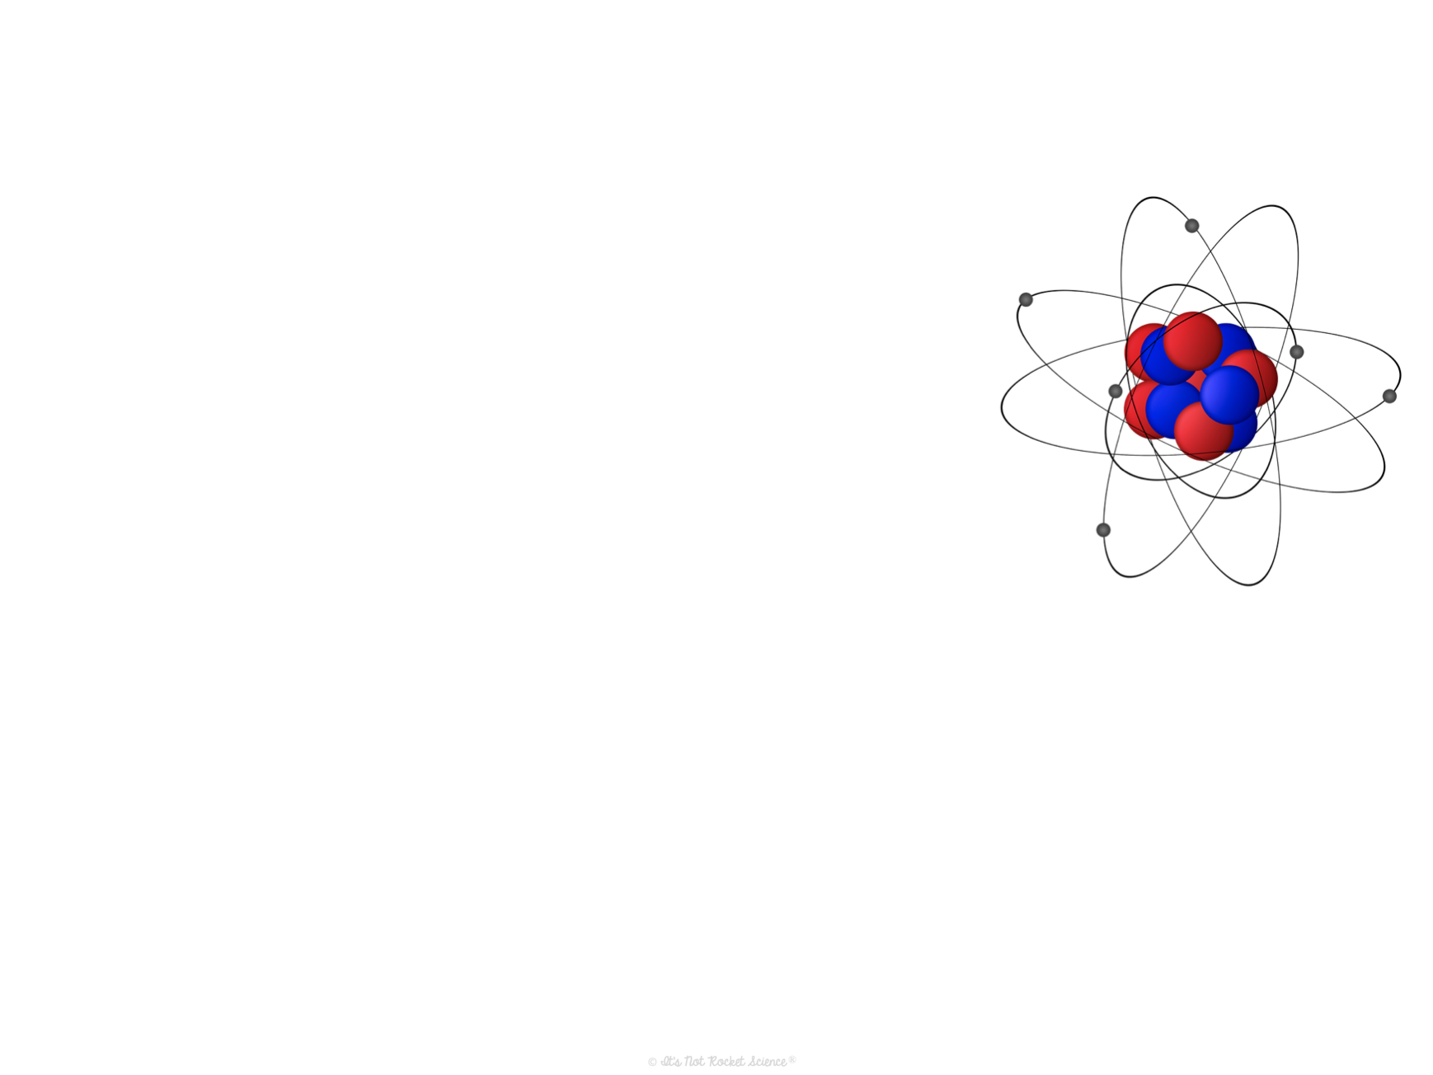
Summary of the Structure
Two parts to the atom:
  Nucleus
    Dense center
    Made of protons and neutrons
    Positively charged
    Where the mass of the atom is located
  Electron cloud
    Space surrounding the nucleus
    Broken down into regions of space called “shells” or “energy levels”
      Electrons in shells further from the nucleus have the most energy
      Electrons in the outermost energy level are called valence electrons
    Negatively charged
    Where the volume of the atom is located

Slide 8
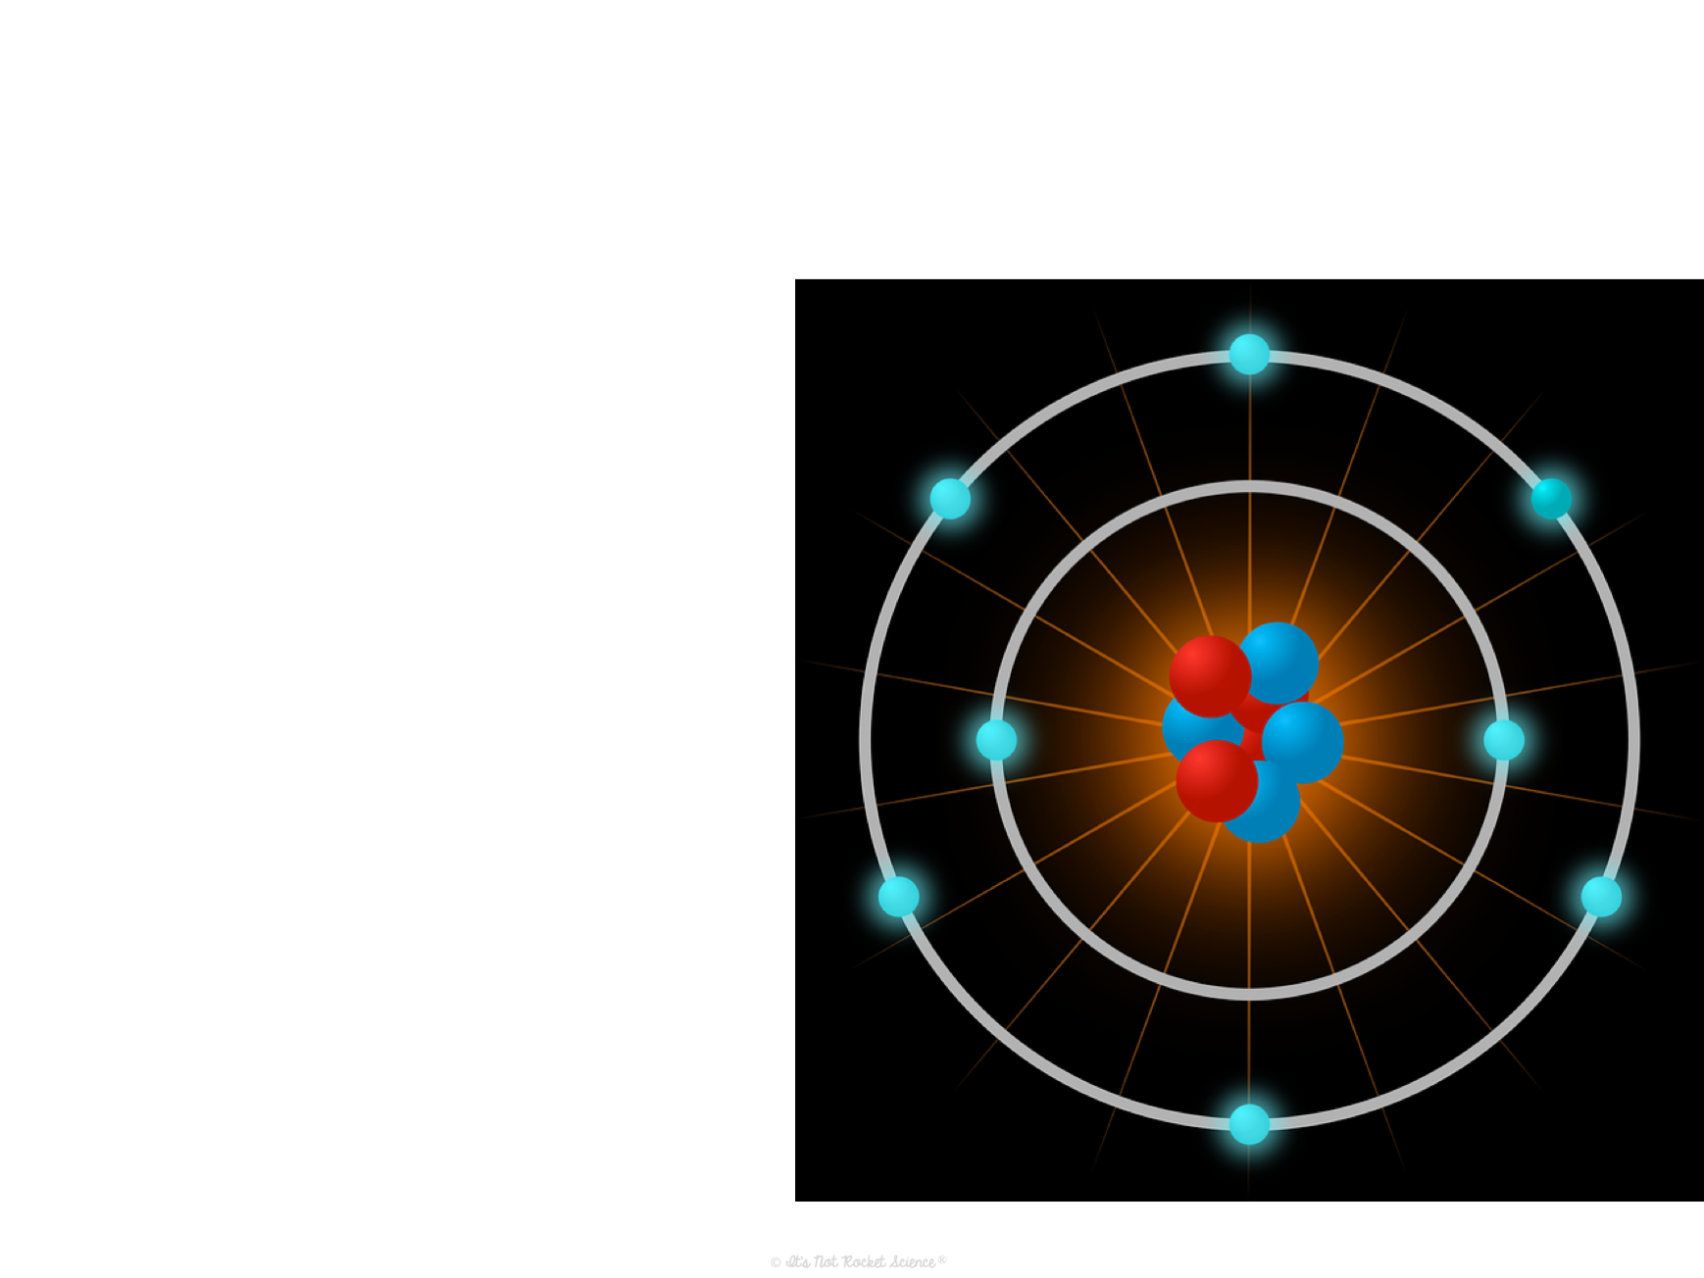
Subatomic Particles
Three particles make up an atom.
Proton: (p⁺) positive particle in the nucleus
Neutron: (n⁰) neutral particle in the nucleus with protons
Electron: (e⁻) negative particle outside of the nucleus in the electron cloud

Slide 9
What holds it together?
Forces:
  Attractive force between the (+) nucleus and (–) electron cloud
    Remember opposite electrical charges attract
    This is what holds the atom together
  Repulsive force between (–) electrons
    Electrons want to be as far apart from each other as possible
    What gives the electron cloud volume
  Repulsive force between (+) protons
    Protons want to be as far apart from each other as possible
    An insane amount of energy holds the nucleus together because of this

