Slide 1
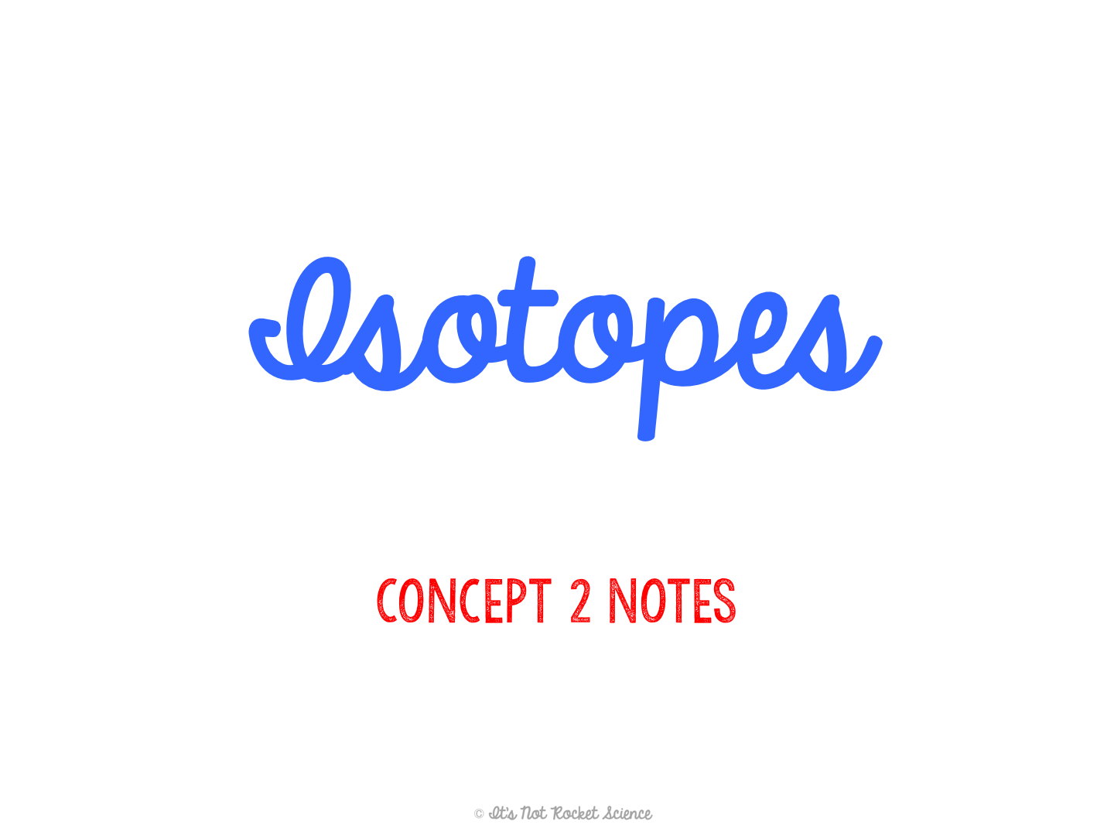

Slide 2
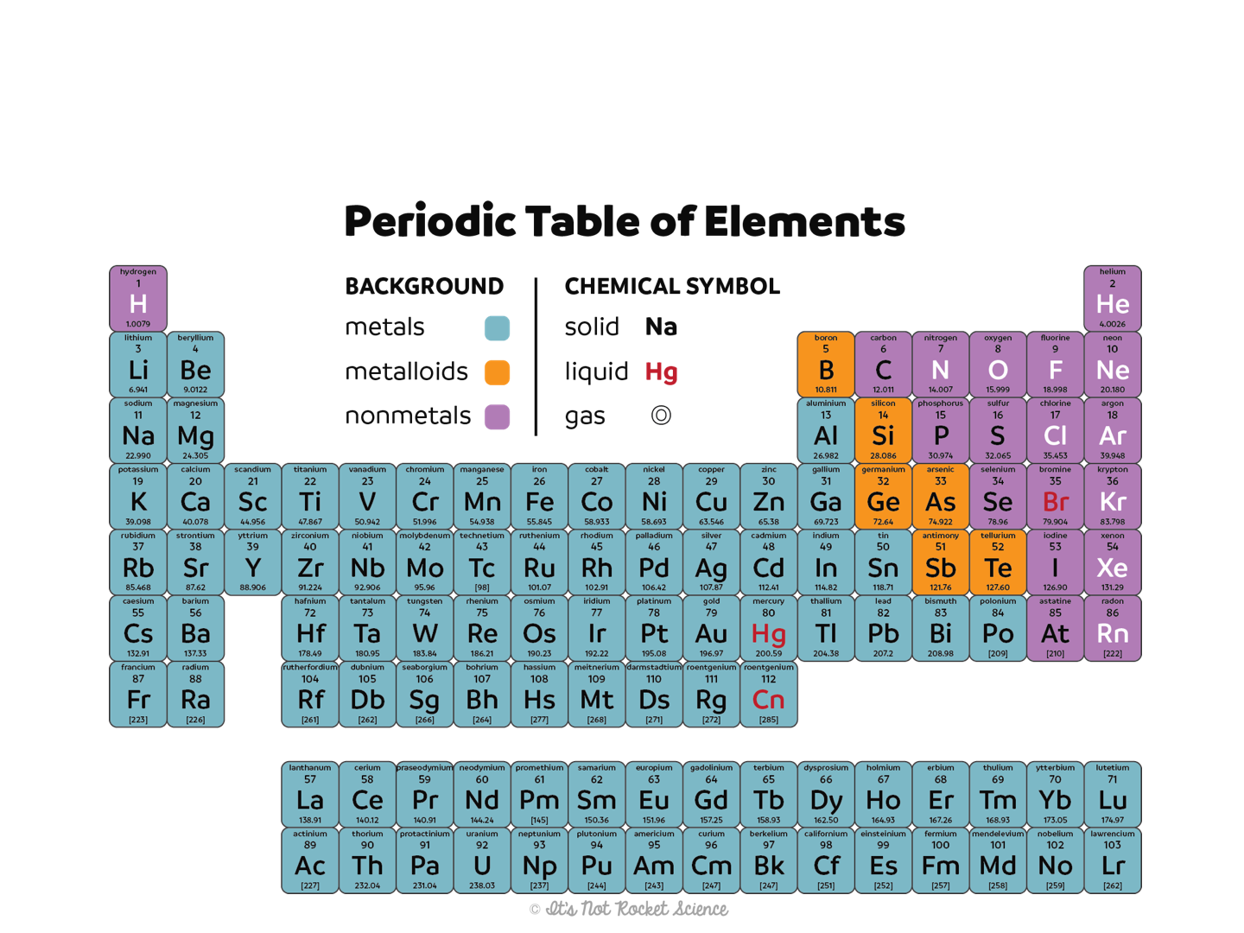
The Periodic Table
What are all of these numbers for?

Slide 3
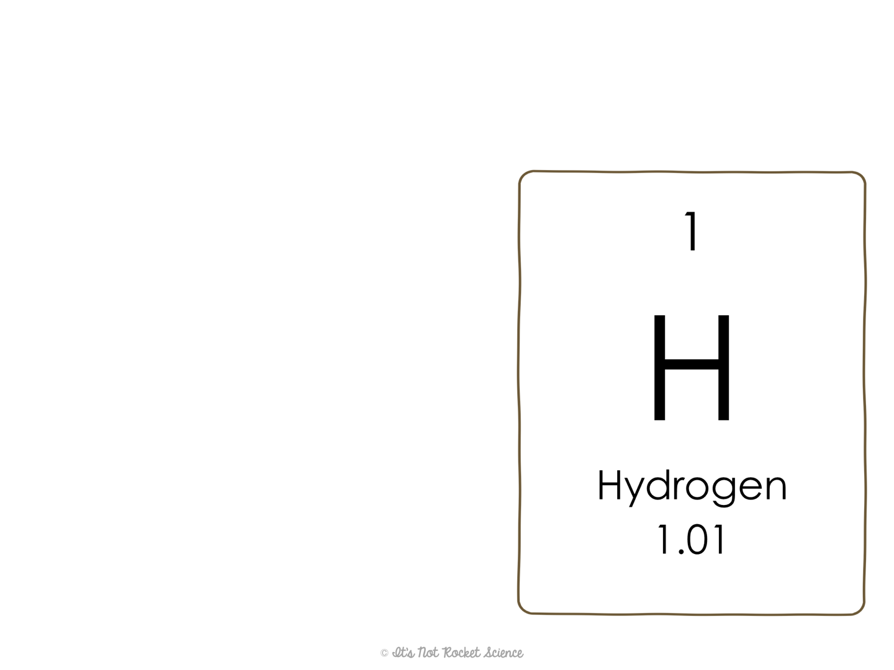
The Periodic Table Notation
Atomic number:
  Tells the number of p⁺ in an atom of the element
  Used to identify an element
  Periodic table arranged by these (thanks to Henry Moseley!)
  In an electrically neutral atom, the # of p⁺ = the total # of e⁻
Symbol:
  Abbreviation for the name of the element

Slide 4
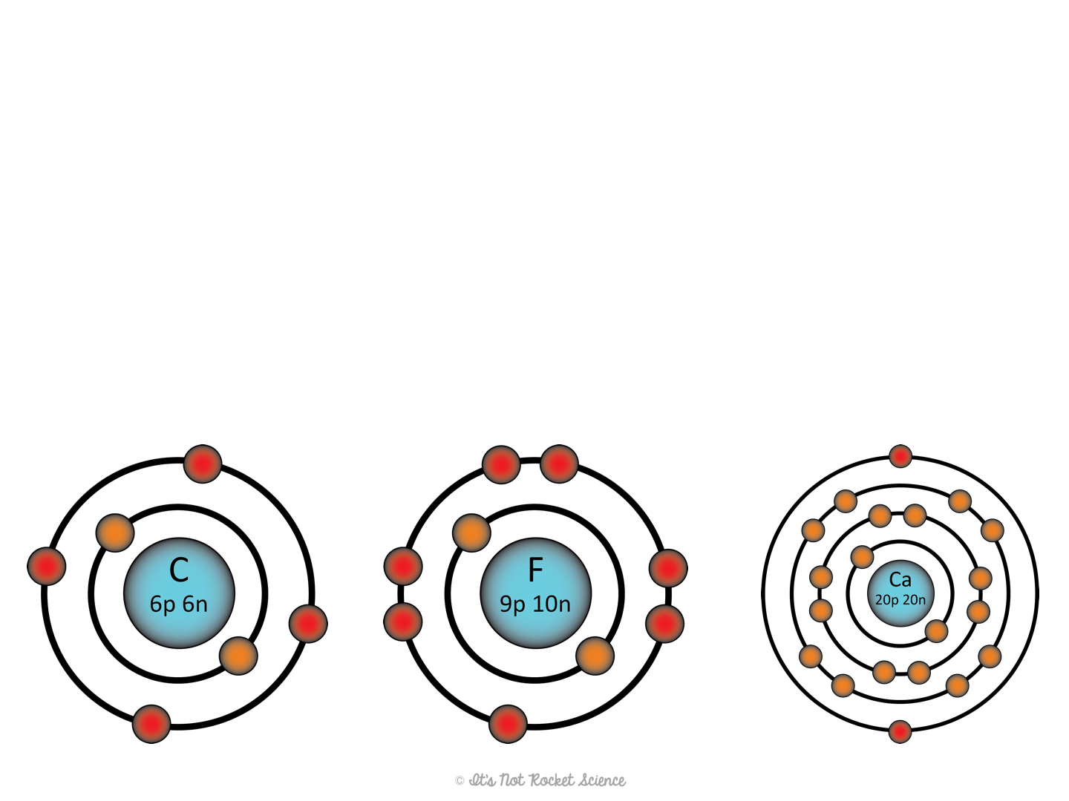
Mass Number
Mass number:
  Not on the periodic table
  Tells the number of protons and neutrons in the nucleus of an atom (where most of its mass is located)
  Example: Find the mass number of the following atoms.
12
19
40

Slide 5
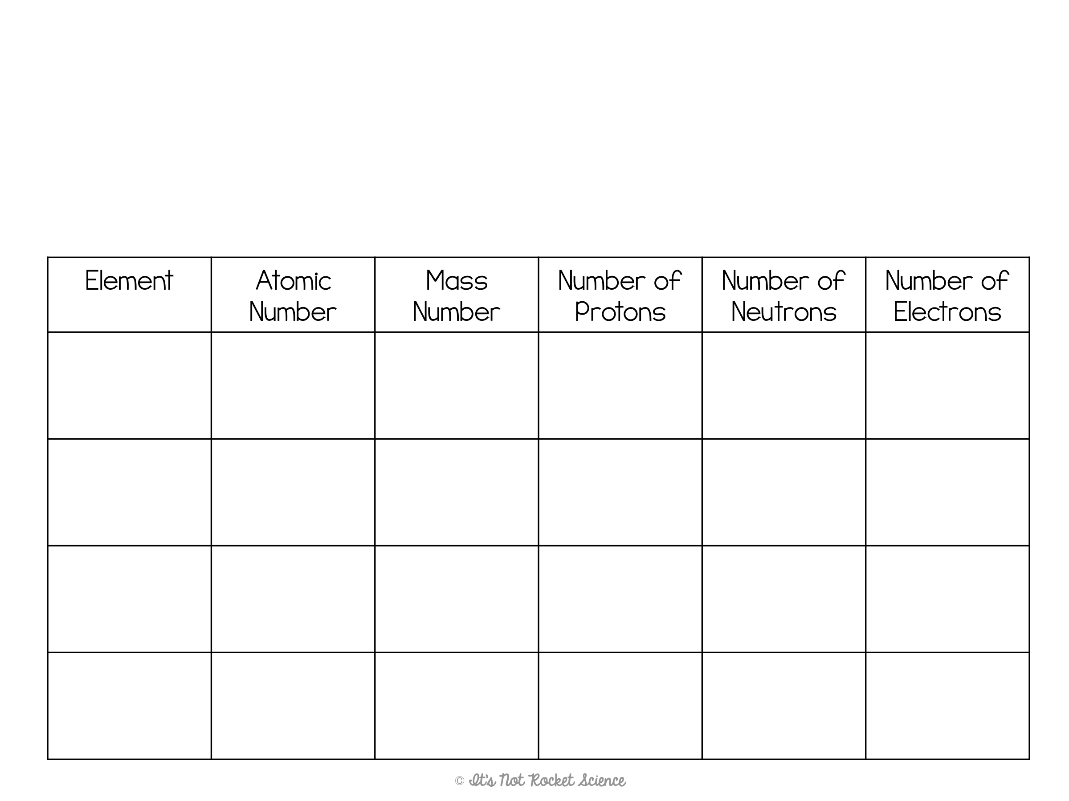
Practice Time!
Use a periodic table and the information provided to complete the rest of the chart about the following four atoms.
On PT
p⁺ + n⁰
Atomic #
Mass # - p⁺
Same as p⁺
Al
13
27
13
14
13
Mn
25
55
25
30
25
Ag
47
109
47
62
47
B
5
11
5
6
5

Slide 6


Slide 7

Isotopes
Not all atoms of an element are identical.
Isotopes: atoms of the same element with different numbers of neutrons.
  Atomic # is same for both, mass # is different
  Ex. Hydrogen-1 vs. Hydrogen-2
  Lower atomic numbers tend to be most stable when the ratio of p⁺ to n⁰ is 1:1.
Notes:
Show them how both atoms have 1 proton (blue) so the atomic number is the same for both (1)
Show them how the top atom has no neutrons (green) so the mass number is just 1 (1 p⁺ + 0 n⁰ = 1)
Show them how the bottom atom has 1 neutron (green) so the mass number is 2 (1 p⁺ + 1 n⁰ = 2)
Note: There are exceptions to the stability thing!!

Slide 8
Isotope Notation
We can notate an isotope one of two ways.
Hyphen form
  Name of element – mass #
  Ex. Potassium – 40
    This would be an atom of potassium with a mass number of 40
      19 protons (because the atomic # is always 19 for potassium)
      21 neutrons (40-19 = 21)
Nuclear form
  ^{Mass #}Symbol
  Ex. ⁴⁰K
    Note: Nuclear notation can also include the atomic # below the mass #, but this isn’t essential since the identity of the element allows you to determine the atomic #

Slide 9
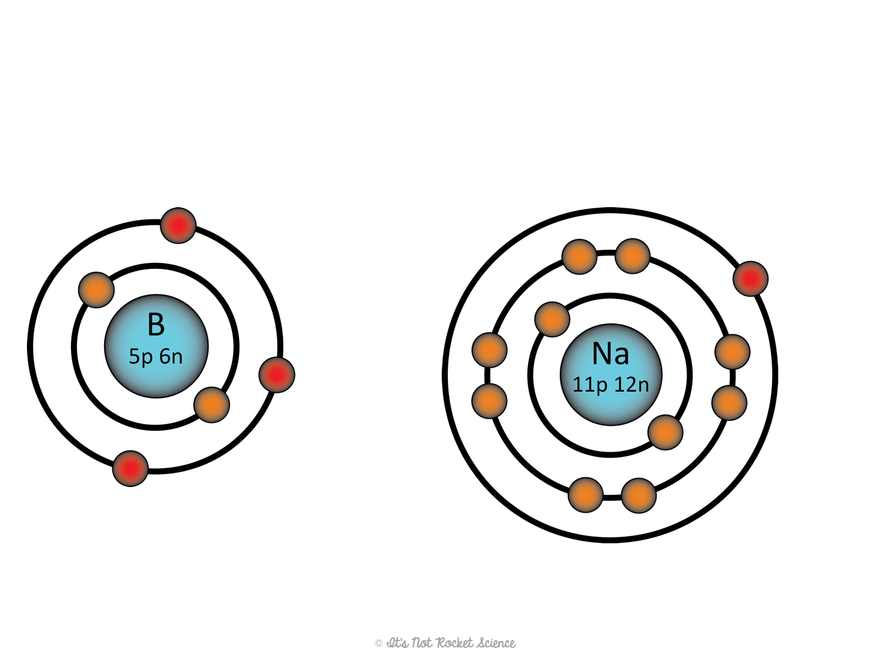
Isotope Notation Examples
Write the hyphen form and nuclear form for each example.
Example #1:
Example #2:
Hyphen form: Boron – 11
Nuclear form: ¹¹B
Hyphen form: Sodium – 23
Nuclear form: ²³Na

Slide 10
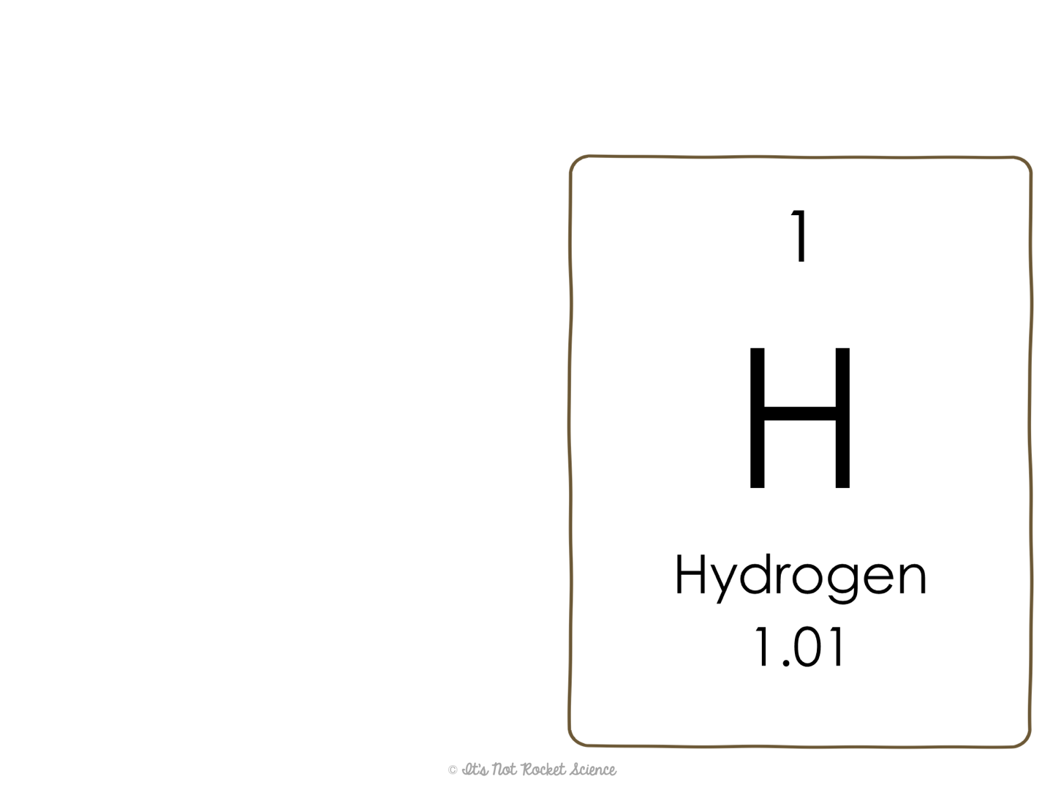
Average Atomic Mass
Average Atomic Mass:
  Weighted average of all of the different versions of an element (called isotopes)
  Closest to the most common isotope of the element
    Ex. The average atomic mass of Hydrogen is 1.01, therefore the most common version of hydrogen in nature is Hydrogen-1

