Slide 2
The Periodic Table
A table organizing all of the elements known to exist by atomic number and chemical properties.

Slide 3
The Periodic Table
Groups: The vertical columns on the periodic table
All elements in the same group have the same number of valence electrons
Remember: valence e⁻ are the e⁻ in an atom’s outermost energy level in the electron cloud
Group 1 = 1 valence e⁻
Group 2 = 2 valence e⁻
(skip the transition metals in groups 3-12)
Group 13 = 3 valence e⁻
(etc. until…)
Group 18 = 8 valence e⁻
With the exception of Helium
Because of this, elements in the same group have similar chemical properties

Slide 4
The Periodic Table
8 valence e⁻
7 valence e⁻
1 valence e⁻
6 valence e⁻
2 valence e⁻
5 valence e⁻
4 valence e⁻
3 valence e⁻
Notes:
I have students label a blank periodic table with the number of valence e-. They will use this as a reference while they study.

Slide 5
The Periodic Table
Group Names to Know:
Group 1 = Alkali metals
Most reactive metals
Note: For metals, reactivity increases as you move down the group
Doesn’t include Hydrogen
Group 2 = Alkaline earth metals
Group 3 = Rare earth metals
Groups 3-12 = Transition metals
Group 17 = Halogens
Most reactive nonmetals
Note: For nonmetals, reactivity decreases as you move down the group
Group 18 = Noble Gases
Nonreactive elements, due to already being chemically stable

Slide 6
The Periodic Table
Noble gases
Halogens
Alkali metals
Oxygen Group
Nitrogen Group
Alkaline earth metals
Carbon Group
Rare earth metals
Boron Group
Transition metals
Notes:
I have students add the group names to their periodic tables. They will use this as a reference while they study.

Slide 7
The Periodic Table
Periods: The horizontal rows on the periodic table
All elements in the same period have the same number of energy levels in their electron cloud
Remember: All atoms have a nucleus with p⁺ and n⁰ surrounded by an electron cloud with e⁻.
Electron clouds are broken down into shells or energy levels, that each hold a certain number of e⁻
Level 1 (closest to the nucleus): holds a max of 2 e⁻
Level 2: holds up to 8 e⁻
Level 3: holds up to 8 e⁻ (for our purposes)
Level 4: holds up to 18 e⁻ (for our purposes)
Notes:
I don’t get into too much detail on electron cloud arrangement for higher levels with my physical science students – I save that for chemistry!

Slide 8
The Periodic Table
1 energy level
2 energy levels
3 energy levels
4 energy levels
5 energy levels
6 energy levels
7 energy levels
Notes:
I have students label the energy levels on their periodic tables. They will use this as a reference while they study.

Slide 9
Atomic Structure and the Periodic Table
An element’s location on the periodic table informs us about its atomic structure.
Example #1: Magnesium
Group 2
Therefore 2 valence electrons
Period 3
Therefore 3 energy levels

Slide 10
Classification of Elements
All elements on the periodic table can be classified as metals, nonmetals, or metalloids
Metals:
Shiny, silvery solids
Good conductors of heat and electricity
Malleable and ductile
Located to the left of the metalloids

Slide 11
Classification of Elements
All elements on the periodic table can be classified as metals, nonmetals, or metalloids
Nonmetals:
Gases, or dull brittle solids
Poor conductors
Right of the metalloids
With the exception of Hydrogen!

Slide 12
Classification of Elements
All elements on the periodic table can be classified as metals, nonmetals, or metalloids
Metalloids:
Solids
Semi-conductors
Physical properties like metals
Chemical properties like nonmetals

Slide 13
Bohr Model Drawings
Bohr Model: simple diagrams that show the atomic structure of an atom

Slide 14
How to Draw:
Determine the number of p⁺ by the element’s atomic #.
Determine number of n⁰ by subtracting.
mass # - atomic #
Place the p⁺ and n⁰ in the nucleus.
Use the period number on the periodic table to determine the number of energy levels in the electron cloud. Draw these around the nucleus.
Put the electrons on each level, filling from the inside out.
(assume the atom is electrically neutral and the total # of e⁻ = the total # of p⁺)
Check that the number of valence e⁻ is the same as the group #.

Slide 15
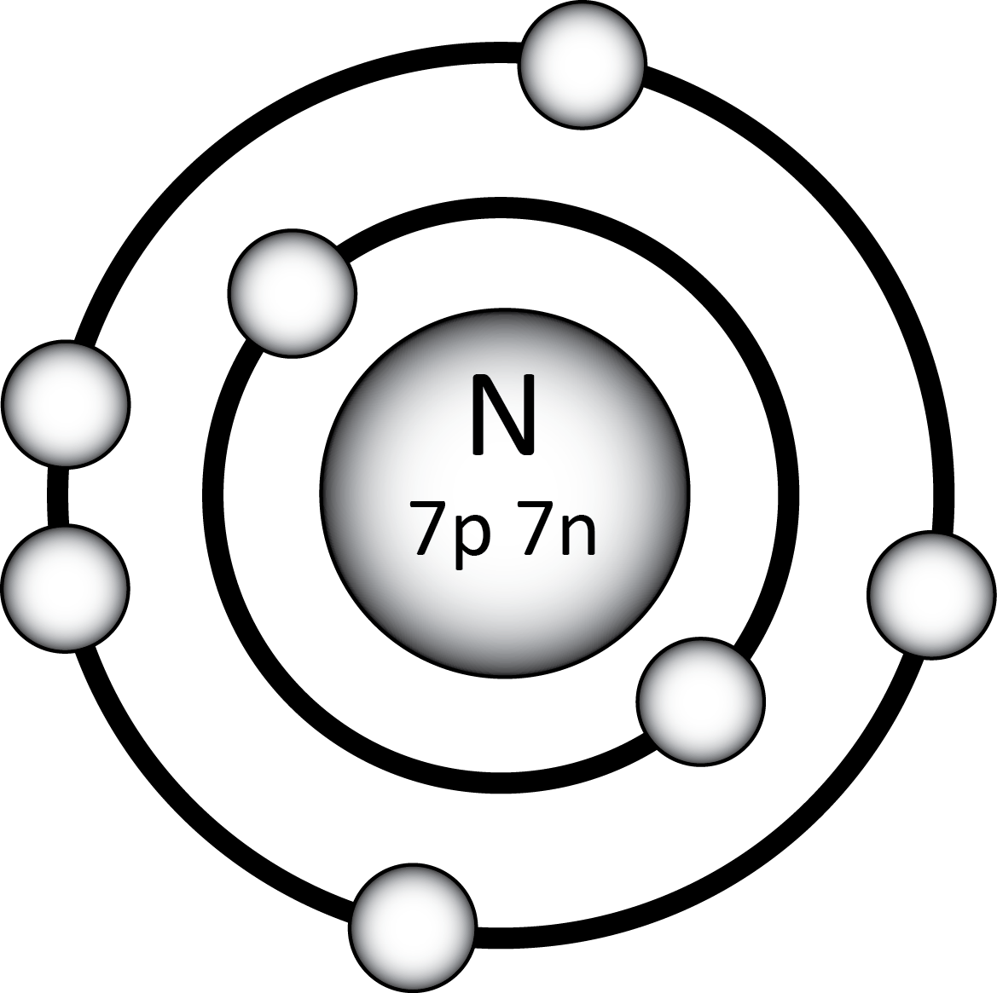
Bohr Model Example
Complete a Bohr Model drawing for Nitrogen.
Notes:
I would walk through this 1 step at a time on the white board and draw it with them before showing the answer on the slide.
If mass number isn’t given, I have them draw the most common version of the element (so look at the average atomic mass on the periodic table and round since that is a weighted average and represents the most common version)

